Slide 1
Analysis of Diamond Data Set
Geeta Sowmya Chethi
Ayushi Daksh
Ram Kashyap Cherukumilli Shivani Bethi

Slide 2
Objective
Dataset
Variable | Variable Description | Variable Type | Range of values
price | In US dollars | Numeric | 326-18,823
carat | Weight of diamond | Numeric | 0.2-5.01
cut | Quality of cut | Categorical | Fair,Good,Very Good,Premium,Idea
color | Color of Diamond | Categorical | J,I,H,G,F,E,D
clarity | How Clear the diamond is | Categorical | I1, SI2, SI1, VS2, VS1, VVS2, VVS1, IF
x | Length in mm | Numeric | 0-10.74
y | Width in mm | Numeric | 0-58.9
Z | Depth in mm | Numeric | 0–31.8
depth | Total Depth percentage = z / mean(x, y) = 2 * z / (x + y) | Numeric | 43-79
table | width of top of diamond relative to widest point (43–95) | Numeric | 43–95
Predict the Price of Diamond based on the predictors of the diamond.
Decide most important features that determine the Price of the Diamond.
This Dataset has 6 numeric variables carat, x, y, z depth, table.
Three categorical variables cut, color, clarity.
54000 records in the dataset.

Slide 3
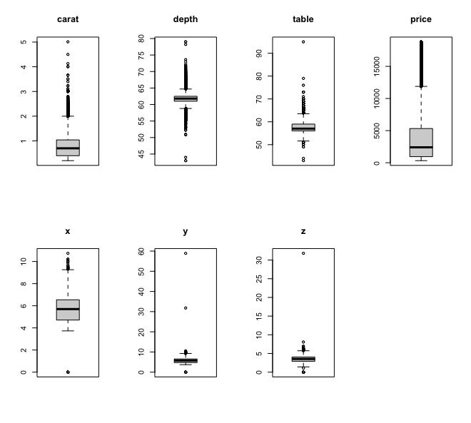
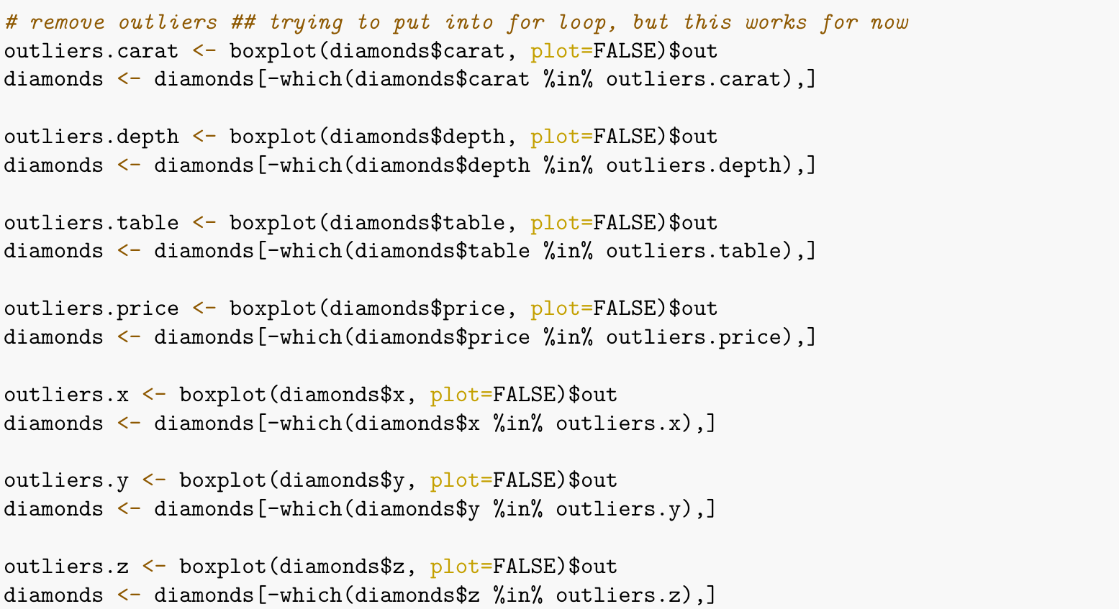
Outlier Detection
Boxplots
Plots of all the numerics features in order to check for the outliers.
Removal of outliers from the numerical columns.
After removing outlier we have 47000 records in our dataset

Slide 4
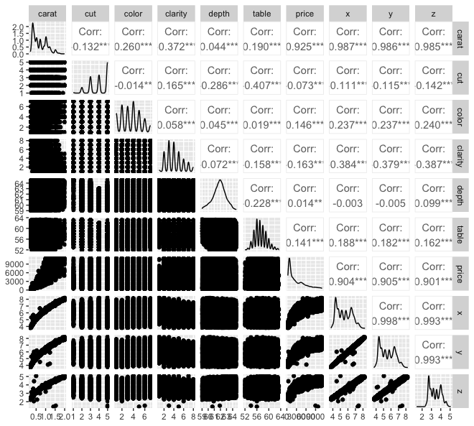
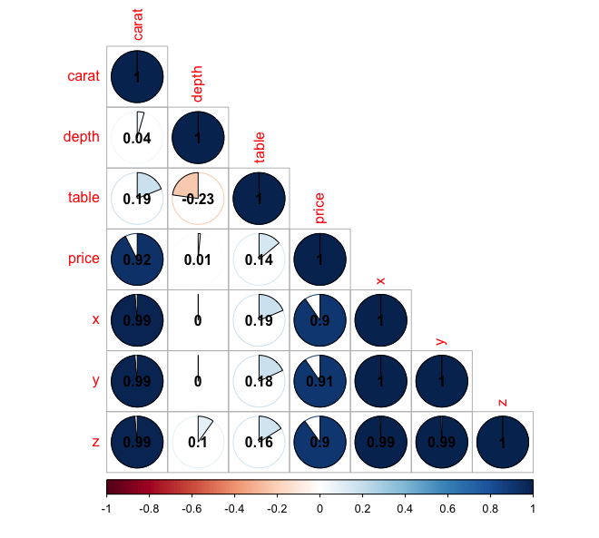
Pairwise Association
From both the plots it is evident that Price is highly correlated to carat
Carat is highly correlated to x, y, z predictors

Slide 5
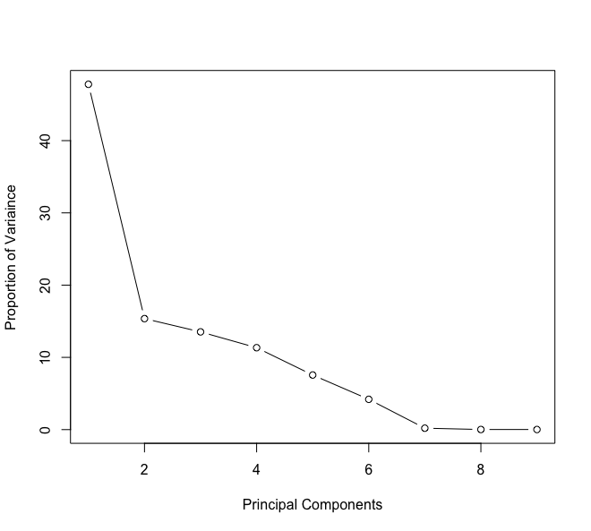
Principle Component Analysis(PCA)
Scree plot
To decide on the most important features Principal component Analysis is uses as it reduces dimensions
From scree plot 6 principal components are required to explain maximum variance of dataset
Built statistical models on first 6 principal components

Slide 6
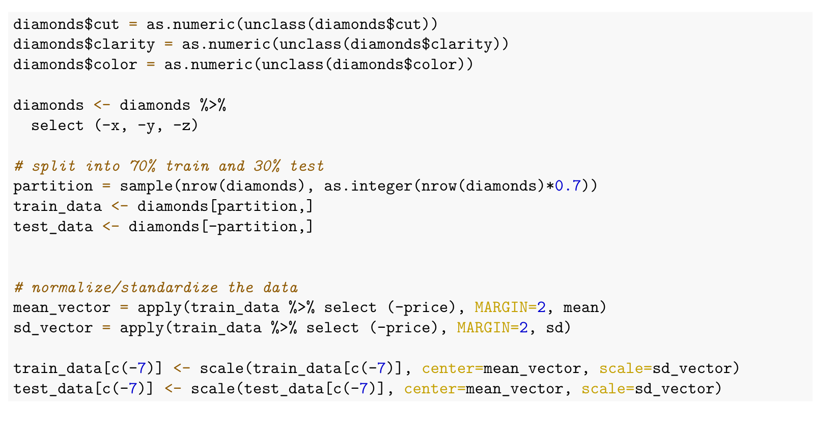
Data Splitting and Encoding
Removed predictors based on EDA
Encoded values for categorical variables
Split the dataset into Train - 70% Test - 30%
Normalization of data

Slide 7
Regression Models
LINEAR REGRESSION:
Making a linear model with a minimum sum of squared residuals/error (SSE) is the aim of linear regression.
Linear Regression , Y = aX +b , where y is the response variable x is the predictor variable. a and b are constants which are called the coefficients.
Using R's lm() utilities, construct a relationship model.
Find the model's coefficients, then use them to construct the mathematical equation.
To find out the average prediction error, get a summary of the relationship model. known as residuals as well.

Slide 8
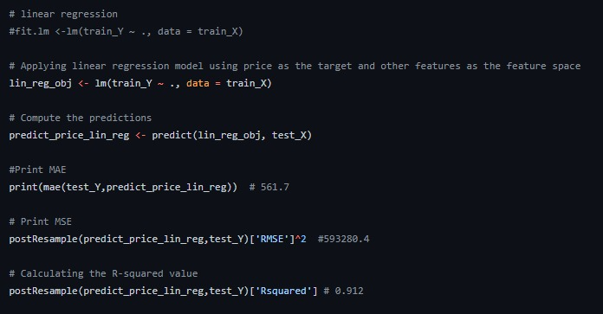
Code snippet(Linear Regression)

Slide 9
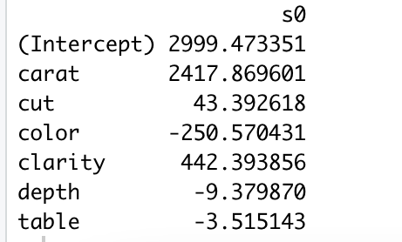
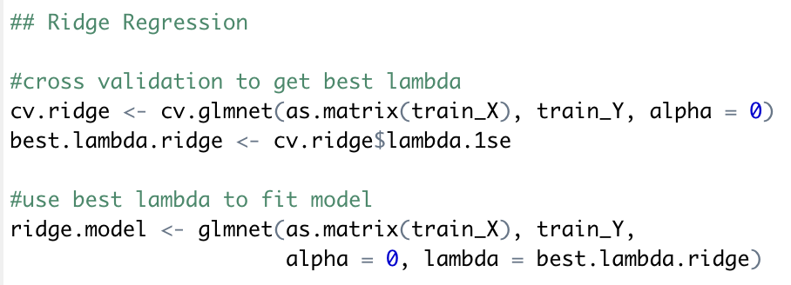
Penalized Linear Regression - Ridge
Best λ : 240.2071
Train MSE : 677572.2
Test MSE : 668929.1
Predictor Importance
carat > clarity > color > cut > depth > table
Shrinkage method - coefficients of variables having minor contribution to the outcome are shrunken close to 0.
Shrinkage is achieved by penalizing the model with penalty term
L2-norm (sum of squared coefficients).
Amount of penalty is tuned using constant term λ.
The best value of λ is the one that minimizes the cross-validation prediction error. It is determined using cv.glmnet().
After getting the best λ, we fit a ridge regression model using that λ value and predict train and test MSE.

Slide 10
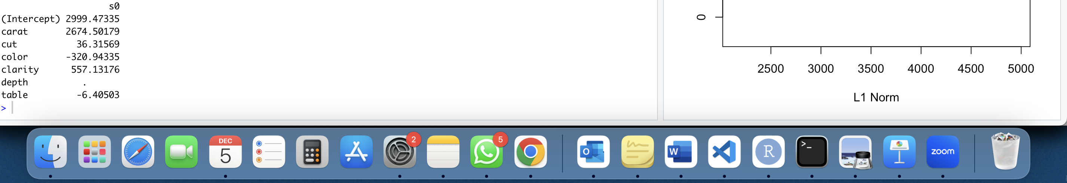
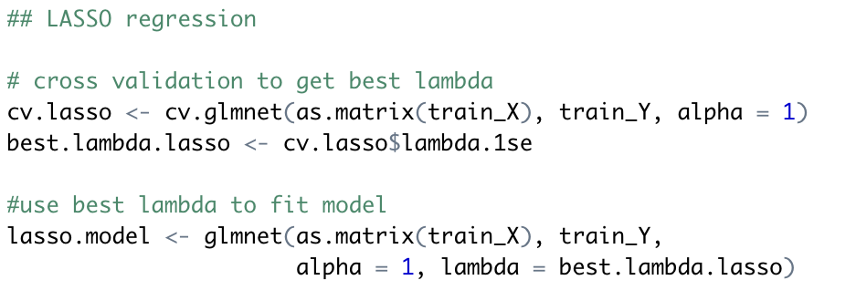
Penalized Linear Regression - LASSO
Best λ : 33.26595
Train MSE : 604506.6
Test MSE : 599609.9
Predictor Importance
carat > clarity > color > cut > depth
Least Absolute Shrinkage and Selection Operator
Shrinkage is achieved by penalizing the model with penalty term
L1-norm (sum of absolute coefficients).
Amount of penalty is tuned using constant term λ.
Sometimes coefficients are shrunken exactly to 0, this acts as subset selection for reducing predictors to reduce model complexity.
The best value of λ is the one that minimizes the cross-validation prediction error. It is determined using cv.glmnet().
After getting the best λ, we fit a ridge regression model using that λ value and predict train and test MSE.

Slide 11
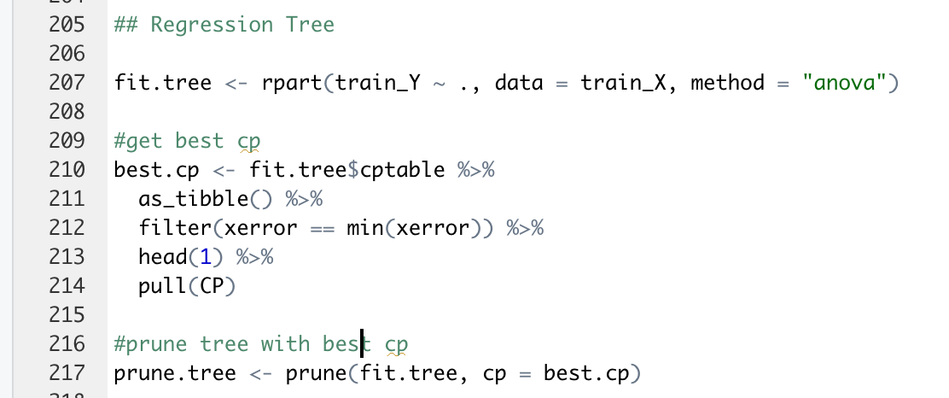
Regression Tree
Best cp : 0.01
Train MSE : 694893.6
Test MSE : 692470.4
Regression Tree is used to partition the data into small subgroups and then fit simple model for each subgroup.
Fit a regression tree using rpart() with method = “anova”
From the fitted model, get the best complexity parameter (cp) value. Best cp is the one with least cross validation error (xerror).
Then we use this cp to get a pruned tree with less number of predictors than the full tree. Pruning is done to avoid overfitting.
Sometimes pruned tree is same as full tree with all predictors.

Slide 12
Bootstrap approach for estimating coefficients
Bootstrap is a method of random sampling with replacement.
It is a simple yet powerful approach for checking the stability of regression coefficients.
Bootstrap samples the data with replacement and estimate the coefficients to decipher how extreme would it be.
It takes the observations and resamples with replacement for some amount of trials and then runs the regression model and saves the coefficients.
The average of these coefficients is taken and then compared with other models that we have previously obtained.
Bootstrap is helpful when we have doubts about the distribution of the data arrived from, or want to check the stability of the coefficients.

Slide 13
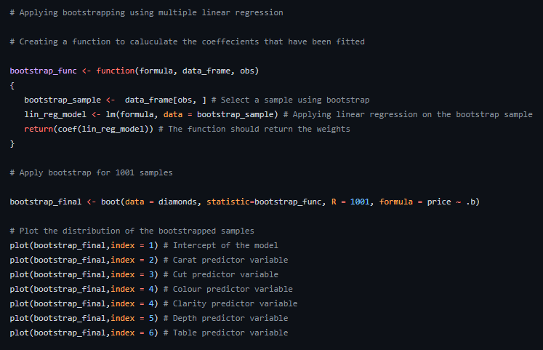
Bootstrapping using linear regression

Slide 14
Random Forest Regression
Random Forest is an ensemble of decision trees i.e. numerous trees are ordered in a certain “random” fashion so as to form a random forest.
Every tree in RF is generated from a distinct sample of rows at each node , a distinct sample of features is being selected for splitting.
The average of these predictions are then used to produce a single result.
The “averaging” aspect makes a RF better than single decision tree, hence it improves its accuracy and reduces overfitting.
The Random Forest Regressor is unable of identifying patterns that would allow it to extrapolate values outside of the training set.
The regressor makes the assumption that in this situation, the prediction will be close to the highest value in the training set.

Slide 15
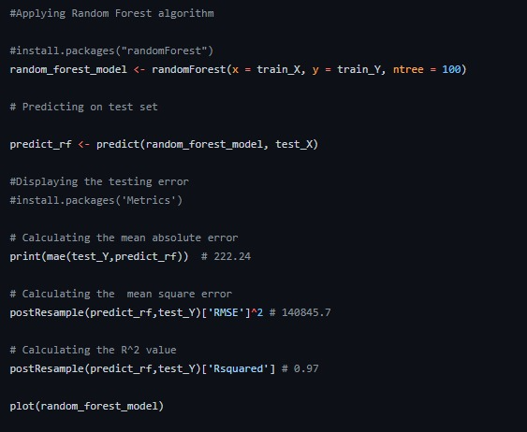
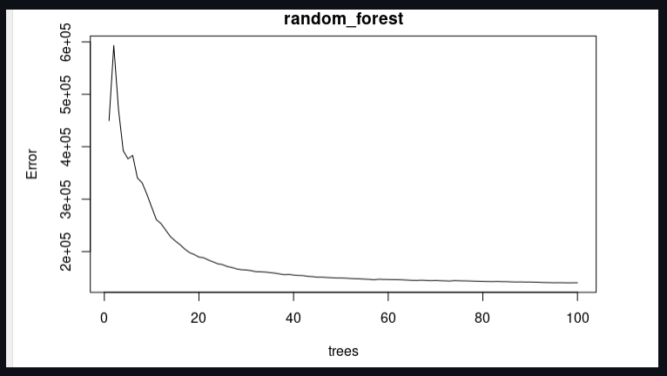
Random Forest implementation

Slide 16
Model Comparison Metrics
Model | Train MSE | Test MSE
Linear Regression | 596245.3 | 593280.4
Ridge Regression | 677572.2 | 668929.1
LASSO | 604506.6 | 599609.9
Regression Tree | 694893.6 | 692470.4
Random Forest | 138480.1 | 138636.5

Slide 17
Conclusion and Recommendations
From comparison of different models, we observe that Random Forest has the least Train and Test MSE and therefore we can conclude that it is the best model.
Regression Tree performs the worst among all models as it has the maximum train and Test MSE which looks right since single tree model are usually highly unstable and a poor predictor. Bagging Regression Tree makes the prediction more effective.
Linear Regression with no penalization performs better than linear models with penalty – ridge and LASSO.
References:
Dataset: https://www.openml.org/search?type=data&sort=runs&id=42225&status=active
Github: https://github.com/raamkashyap/Analysis-Of-Diamond-Dataset

Slide 18
Thank You!

